Slide 1

Overview Spring Ecosystem
[BANG NGO]

Slide 2
Scenarios
Nowadays, Spring is not a framework but an ecosystem for the real world enterprise applications.
From configuration to security, web apps to big data—whatever the infrastructure needs of your application may be.

Slide 3
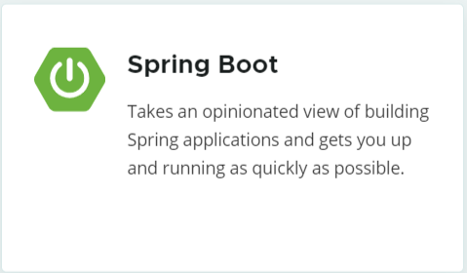
Spring Boot
Create stand-alone Spring applications.
Embed Tomcat, Jetty or Undertow directly (no need to deploy WAR files).
Automatically configure Spring and 3rd party libraries whenever possible.
Provide production-ready features such as metrics, health checks, and externalized configuration
Absolutely no code generation and no requirement for XML configuration

Slide 4
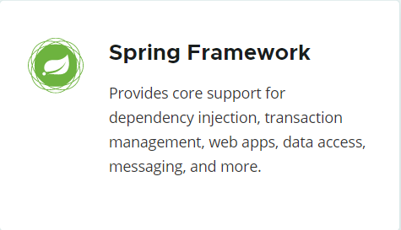
Spring Framework
Core: dependency injection, events, resources, i18n, validation, data binding, type conversion, SpEL, AOP.
Testing: mock objects, TestContext framework, Spring MVC Test, WebTestClient.
Data Access: transactions, DAO support, JDBC, ORM, Marshalling XML.
Spring MVC and Spring WebFlux web frameworks.
Integration: remoting, JMS, JCA, JMX, email, tasks, scheduling, cache.
Languages: Kotlin, Groovy, dynamic languages.

Slide 5
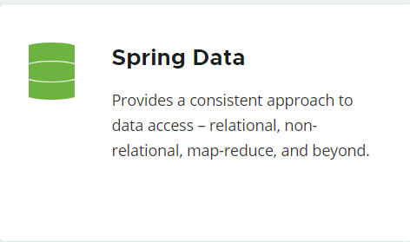
Spring Data
Powerful repository and custom object-mapping abstractions.
Dynamic query derivation from repository method names.
Implementation domain base classes providing basic properties.
Possibility to integrate custom repository code.
Advanced integration with Spring MVC controllers.
Experimental support for cross-store persistence.

Slide 6
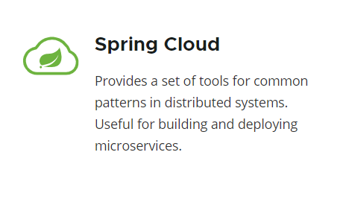
Spring Cloud
Distributed/versioned configuration.
Service registration and discovery.
Routing.
Service-to-service calls.
Load balancing.
Circuit Breakers.
Global locks.
Leadership election and cluster state.
Distributed messaging.

Slide 7
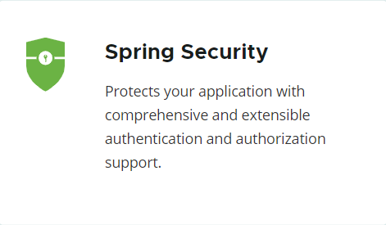
Spring Security
Comprehensive and extensible support for both Authentication and Authorization.
Protection against attacks like session fixation, clickjacking, cross site request forgery, etc…
Servlet API integration.
Optional integration with Spring Web MVC.
Much more…

Slide 8
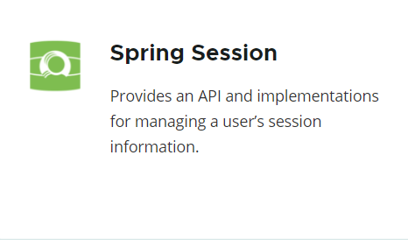
Spring Session
Allows replacing the HttpSession in an application container (i.e. Tomcat) neutral way, with support for providing session IDs in headers to work with RESTful APIs.
Provides the ability to keep the HttpSession alive when receiving WebSocket messages.
Allows replacing the Spring WebFlux’s WebSession in an application container neutral way.

Slide 9

Thank You!

